Slide 1
Journey to contribution
Focus on the Mojaloop Toolkit (TTK)
Elijah Okello, Paul Baker, Sam Kummary
Notes:
My name is Paul Baker , I am an Engineering Manager at INFITX , and am happy to be presenting at this Mojaloop convening.
INFITX is a motivated team of Inclusive Financial Technology eXperts focused on enabling equitable financial outcomes.
We do this by supporting Financial Institutions, FinTechs, System Integrators and all adopters of Mojaloop in building capacity and providing technical assistance to ensure successful service delivery.
Today I am going to be talking to you about the journey of becoming a Mojaloop contributor with a particular focus on the Mojaloop Toolkit, and how you can use that toolkit to support you along that journey.
There are three main point that I would like you to gain from this talk
Making a contribution to mojaloop; is something that all of us here can do
Better understanding of Mojaloop Tookit and the ways it is used
Wider implications - DPGs context; and what that future tool could look like.

Slide 2

Mojaloop Toolkit (TTK)
Open API toolkit
Connecting systems & Building PoCs
→ Exploring; Simulating; Demonstrating APIs & (new) use-cases
Development against an API
→ OpenAPI definition validation; mocking & monitoring
Start with working test case; develop component to replace API calls
Validating APIs
→ building & executing tests; managing collections & reports; mocking APIs; CI validation; helm deployment tests
Notes:
The OpenAPI Specification (OAS) defines a standard, language-agnostic interface to HTTP APIs which allows both humans and computers to discover and understand

Slide 3
Diverse audience
Meeting place of
Product Owners and Product Consumers
Coders and non-coders
Developers & quality assurance experts
Exploring ideas & repeatable test cases
Designed Functions & Designed Failures
UI based & CI execution
Product Demonstration & Integration Validation

Slide 4
Why?
Tool that supports all Mojaloop Pillars
mojaloop
Capacity Building
Support adoption and mojaloop contributions (API exploring & explaining, Dev env, POC)
Exploring a new use case; POCs
Build POCs when connecting systems
Functional test harness that developers can run locally, in a CI environment, or run as deployment tests
Make Adoption Easier
Achieve Scale
Connect to Other Systems
Quality Product

Slide 5
System Integrators
Journey of onboarding a DFSP
Training on APIs
Run Local
Deploy to Sandbox
Configure CI test harness
Configure deployment tests
Example of the API calls
Build integrations
Monitor
Build functional test set
Ensure integration handles all error cases

Slide 6
Hub Operators
Building the Hub
Run Local
Mini-loop
Configure CI test harness
Deploy to Sandbox
Configure deployment tests
Test-harness
POC
Demo
Use case test set

Slide 7

Pre Program
Activities
⟳Orchestrating a Mojaloop Scheme Business and building Capacity
Scheme Stakeholders
Regulators
Hub operators
Wallet Providers
Banks
MFIs / SACCOS
Fintechs
Developing the business case
Deploying a sandbox
Initial use-case chosen
Commitment from Regulator
Hub operator appointed
Sandbox Built
⟳Business case for scheme, hub & participants
⟳Scope of Scheme, Hub, Regulator & Participants defined
⟳Scheme aligned to Regulator for use-case ⟳Seek Regulator approval or no objection
⟳Scheme Rules defined
⟳Hub operator chosen
⟳Letter of commitment from Participants
Stage
Delivery
⚑
Setting up for Go-live
Building the hub
Production system built + real money transactions
Scheme Legal entity defined
Minimum participant connections reached
UAT passed
Settlement Bank process defined
⟳Regulator approval
⟳Production system built
⟳DFSP taken live
⟳Scheme built
⟳Governance defined
⟳Participant agreements
⟳Participants connected
⟳Use-case functional and non-functional components built and tested
⟳Scheme Rules defined
⟳Settlement Bank chosen

Slide 8

Journey to contribution
Mojaloop Community
Mojaloop Training Program (MTP)
Testing Toolkit
ML workstreams
Notes:
Discussion with Elijah

Slide 9

Mojaloop Toolkit
- wider implications
APIs are where the digital public goods projects meet.
Need to demonstrate interoperability between the systems.
Having a combined and shared understanding is useful
Open API definitions
Sequence diagrams
→ A good demonstration tool based on agreed API interfaces.

Slide 10
Mojaloop Toolkit - good product market fit
It takes time to get developer teams to try TTK, but once they do, they don’t stop praising it.
→ Good product market fit
Examples: PISP delivery team; ISO 8583 team, Mojaloop vNext; Mojaloop Golden Path test collection; Miniloop;
Survey feedback link

Slide 11
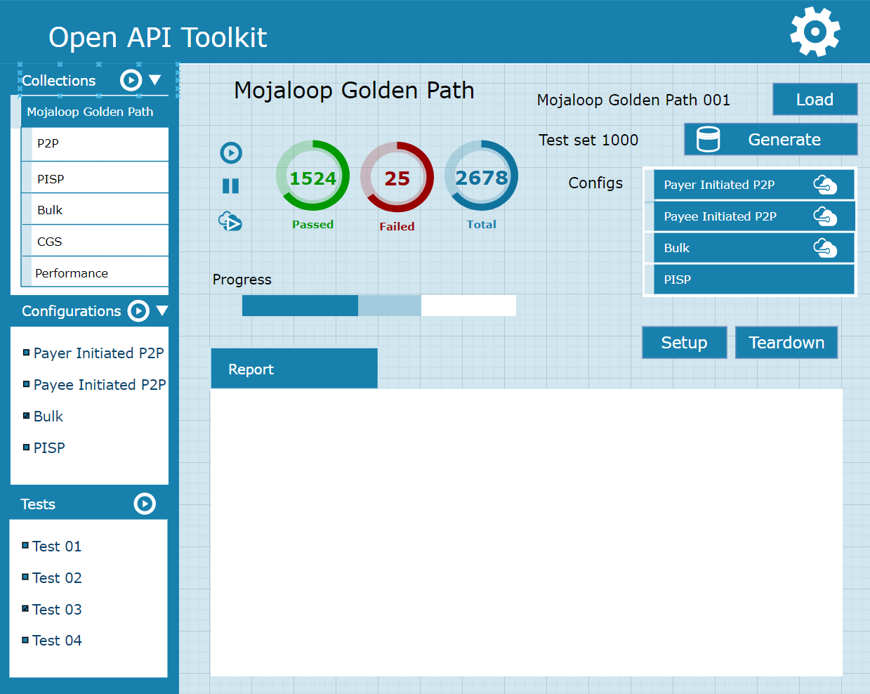
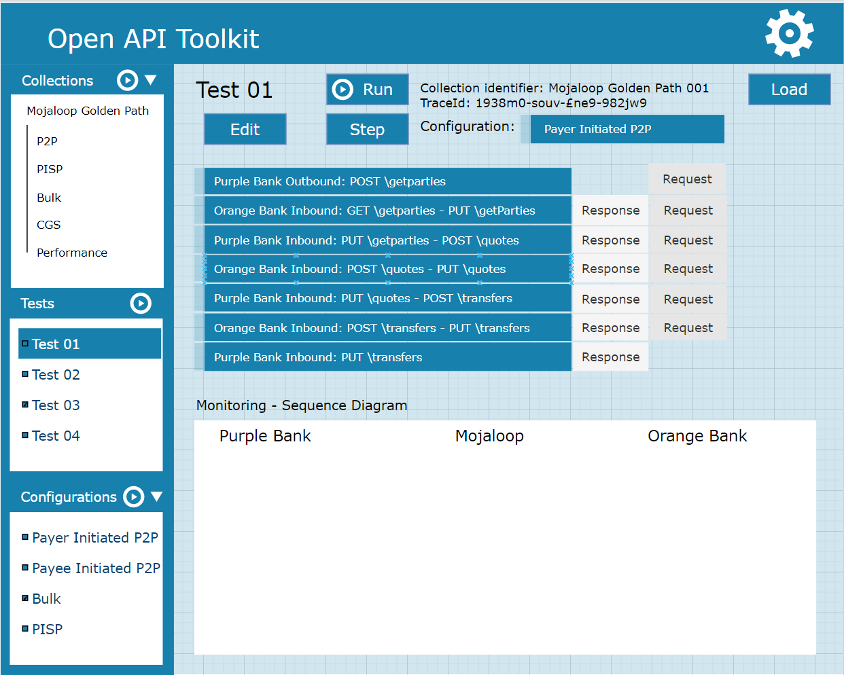
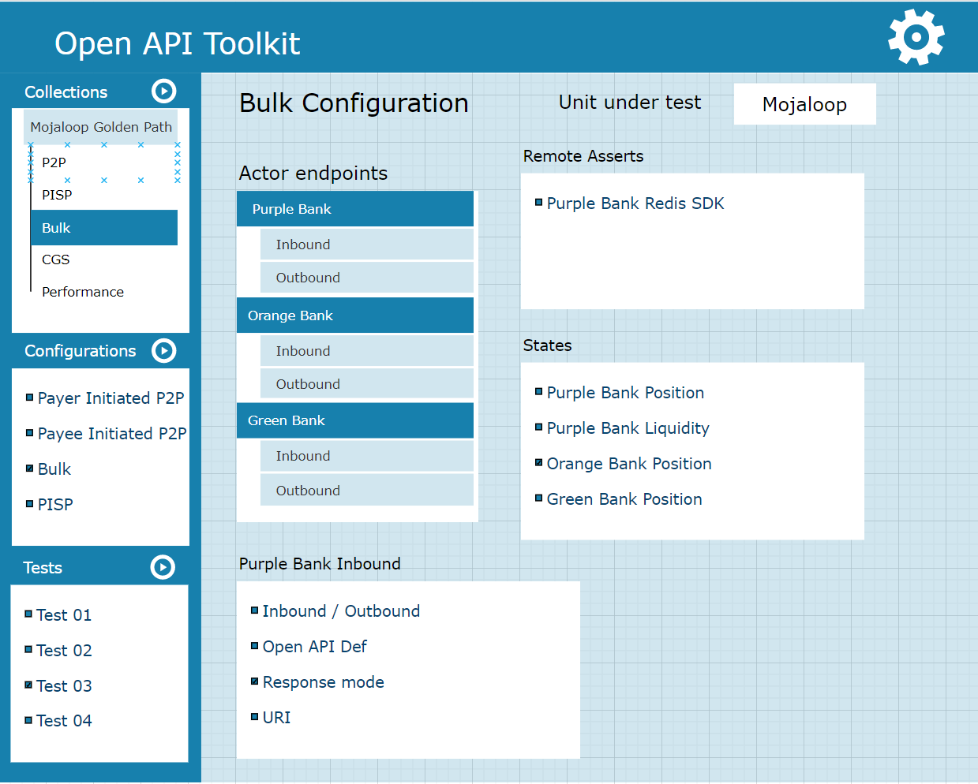
What could the future look like?
Generalisations
Hub mode state stores
Explicit test configuration
Asserts
Test Report delivery/storage
Tying mock rules to tests by using open tracing standards.
Puggable micro-front end demonstration UI
More feature enhancements
Refactor UI
Decoupling of UI from test running
Enhance test data parameterisation

Slide 12
Making the most of an API first approach
Open API definition
Exploring
Validation
Prepopulation of test cases & examples
Prepopulation of Mock responses
Enables complex state flow mocking and responding as multiple system components
Asynchronous calls

Slide 13
References
Survey feedback link
Mojaloop Training Program Course
Build a Mojaloop Integration Harness
Mojaloop Toolkit Github repository
Mojaloop Toolkit UI repository
Mojaloop Toolkit testsets
Mojaloop Test Harness
Mini-loop
Payment Manager Integration Harness
PISP Bootcamp POC

